Slide 1
Development Processes I: Stage-Gate & Waterfall
Readings: Schilling (2022) Ch02, Steiber (2022), Cooper (2021) Ch04 Modern Case: Microsoft’s Responsible AI Principles (2022)

Slide 2
Lecture Overview
The role of development processes in innovation.
Traditional models: Waterfall & Stage-Gate.
Managing risk and resource allocation.
Theoretical foundations: CPM and SDLC.
Microsoft Azure & Responsible AI case.
Class activity: Simulate a Stage-Gate review.

Slide 3
Learning Outcomes
By the end of this session, students should be able to:
Explain the Stage-Gate and Waterfall development models.
Apply CPM and structured project management methods.
Identify limitations of linear models in modern digital innovation.
Conduct a Stage-Gate review using Microsoft’s Responsible AI framework.

Slide 4
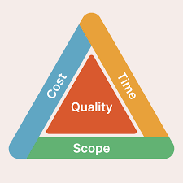
Why Development Processes Matter
Innovation success ≠ Great idea only → requires disciplined execution.
40–50% of new products fail due to poor process management (Cooper).
Development processes:
Reduce uncertainty.
Manage time, cost, and quality trade-offs.
Enable organizational learning across projects.

Slide 5
The Traditional View of Innovation Development
Schilling (2022): Early innovation models viewed development as linear, sequential, and controllable.
Emphasis on planning and documentation before coding/testing.
Works well for hardware, regulated industries, and capital-intensive innovation.

Slide 6
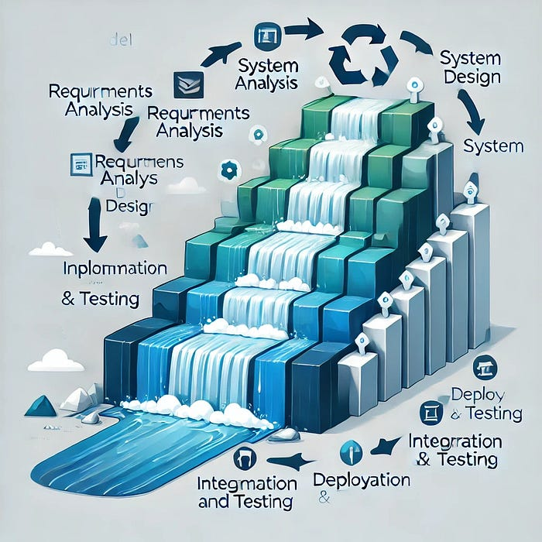
Waterfall Model Overview
Origin: Winston Royce (1970).
Process: Sequential phases — Requirements → Design → Implementation → Testing → Deployment → Maintenance.
Principle: Each phase must be completed before the next begins.

Slide 7
Advantages of Waterfall
Clarity and simplicity of stages.
Clear documentation and accountability.
Easier project tracking and control.
Works well for stable environments with fixed requirements.
Example: Aerospace systems and large-scale ERP implementations.

Slide 8
Limitations of Waterfall
Assumes requirements remain stable.
Delays user feedback until late in the cycle.
Costly to make changes once design is locked.
Unsuitable for fast-moving digital innovation (Steiber, 2022).
Example: Software projects failing due to changing AI ethics regulations.

Slide 9
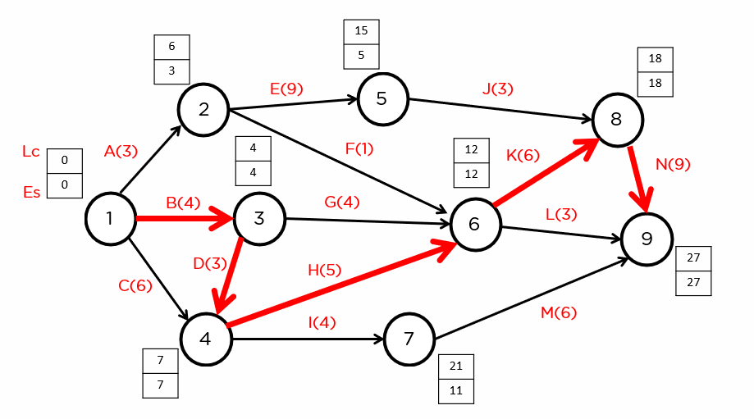
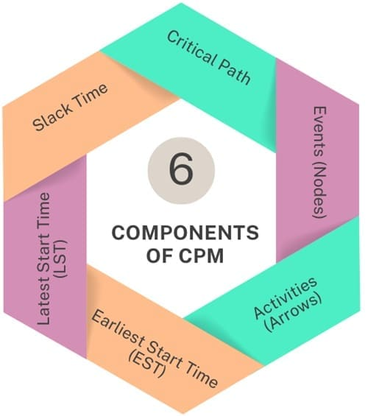
The Critical Path Method (CPM)
Tool for identifying the longest path in a project schedule that determines minimum completion time.
Helps allocate resources efficiently.
Key terms:
Activity: Task requiring time/resources.
Path: Sequence of dependent activities.
Critical Path: Longest duration path → delays here delay entire project.
E.g., https://www.simplilearn.com/tutorials/project-management-tutorial/critical-path-method

Slide 10
CPM in Innovation Projects
CPM enhances visibility of project dependencies.
Used in Stage-Gate planning to define gate readiness.
Useful for resource-heavy technology projects (data centers, hardware).
Limitation: Ignores iterative learning cycles required in AI/ML systems.

Slide 11
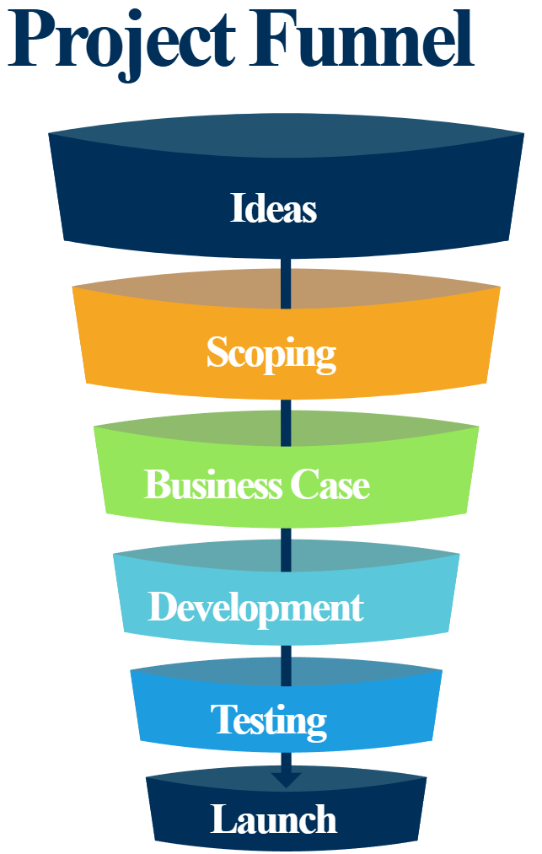
Stage-Gate Process (Cooper, 2021)
Definition: A structured, stepwise framework guiding a project from idea to launch.
Stages: Execution phases (idea, design, testing).
Gates: Review points where continuation decisions are made (“Go/Kill”).

Slide 12
Typical Stage-Gate Stages
Stage | Focus | Deliverables
1. Discovery | Idea generation | Preliminary concept
2. Scoping | Market/tech assessment | Opportunity definition
3. Business Case | Feasibility, financial analysis | Business plan
4. Development | Prototyping | Product prototype
5. Testing & Validation | Market & technical tests | Refined design
6. Launch | Commercialization | Market introduction

Slide 13
Gate Review Criteria
Each gate includes:
Quality of execution (technical, financial, user requirements).
Business rationale (market potential, ROI).
Alignment with strategy.
Gatekeepers: cross-functional senior team.

Slide 14
Advantages of Stage-Gate
Risk management through early screening.
Resource focus on high-value projects.
Structured documentation → organizational learning.
Balances creativity with discipline.

Slide 15
Limitations of Stage-Gate
Can be bureaucratic if overformalized.
Slows innovation in fast-moving tech sectors.
Not ideal for exploratory AI or data-driven innovation.
Cooper (2021): calls for “Next-Generation Stage-Gate” → adaptive & agile integration.

Slide 16
Schilling’s View on Development Processes
Stage-Gate aligns with planned innovation management.
Effective for complex, capital-intensive innovations.
Schilling (Ch. 11): Integration across marketing, R&D, and production crucial for success.
Coordination barriers = key reason for project delays and cost overruns.

Slide 17
Integrating Leadership for Innovation (Steiber, 2022)
Traditional processes require modern leadership adaptation:
Visionary alignment: Leaders communicate “why” innovation matters.
Empowerment: Teams must feel ownership of each gate stage.
Psychological safety: Encourage openness about risks or failures.
“Digital leadership” complements structured methods with agile thinking.

Slide 18
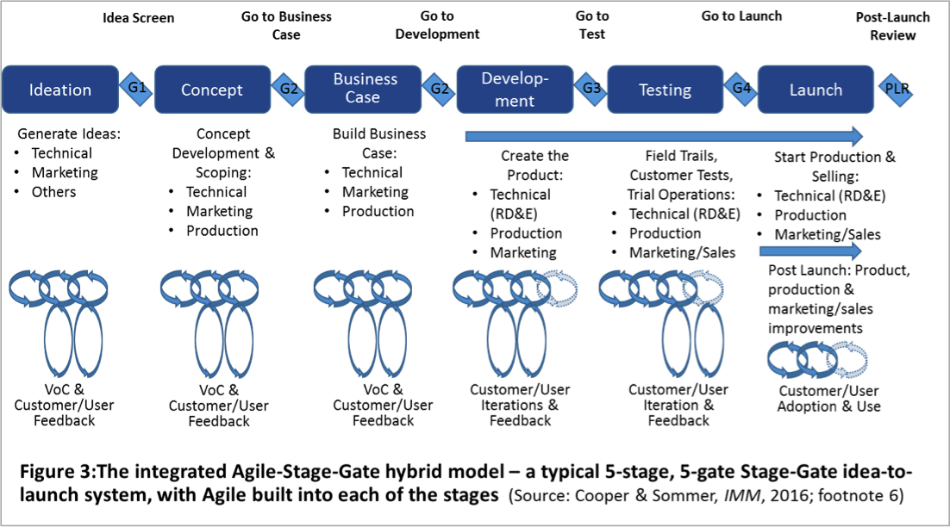
Hybrid Models in Digital Firms
Modern firms (Microsoft, Google, Amazon) blend Stage-Gate rigor with agile flexibility.
Example: Mini “sprints” within each stage.
Gates become learning checkpoints, not rigid control points.
https://innovationmanagement.se/2016/08/09/integrating-agile-with-stage-gate/

Slide 19
Agile/ Hybrid Stage-Gate
Merits
Limitations
Improved design flexibility
Increased ability to respond to real-time changes
Boost in productivity, communication, and coordination across entire project team
Higher overall team morale
Better prioritization of project tasks
Reduced time-to-market by 30% (vs. classic Stage-Gate processes)
Difficulty to secure dedicated team members focused on only one project
Difficulty linking project teams to the organization as a whole
Disconnect between Agile requirements and the company’s reward system
Perceived as still being too bureaucratic
Lack of scalability for large projects with many interconnected sub-projects
Hard to manage for distributed global teams
Too much time spent in meetings (vs. working)
Sometimes challenging to secure management buy-in

Slide 20
Microsoft’s Stage-Gate Approach
Microsoft uses Stage-Gate in Azure and AI model development.
Key adaptations:
Ethical checkpoints integrated into gates.
Multidisciplinary gatekeepers: engineers, ethicists, policy experts.
Focus on risk prediction, bias reduction, and compliance.

Slide 21
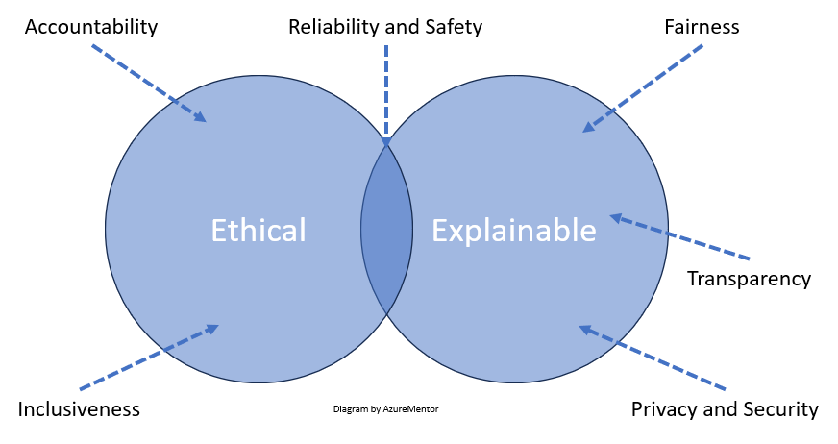
Microsoft’s Responsible AI Principles
Fairness
Reliability and Safety
Privacy and Security
Inclusiveness
Transparency
Accountability
→ Integrated into development process as evaluation gates.
https://azurementor.wordpress.com/2024/03/08/the-6-microsoft-responsible-ai-principles-explained/

Slide 22
Case Study: Responsible AI Gate Simulation
Scenario:
You are part of the AI ethics board in MENA Region, reviewing a new Azure cognitive service.
Your Task:
Evaluate the AI system across the 6 principles.
Identify which gate the project is at (e.g., development/testing).
Recommend: Go, Hold, or Rework, and justify.

Slide 23
Activity Setup
Group size: 5–6 students.
Duration: 15–20 minutes.
Outputs:
Identify 3 major ethical/technical risks.
Prepare a 3-minute presentation simulating a gate review.

Slide 24
Debrief Discussion
What were your main criteria for the gate decision?
How did you balance innovation speed vs responsibility?
How might a hybrid Stage-Gate process improve oversight?

Slide 25
Leadership Reflection
Steiber (2022): Leadership in digital innovation = balancing speed, ethics, and learning.
Microsoft example shows responsible leadership integrated into a technical process.
Key takeaway: Ethical review is not an add-on; it’s a design parameter.

Slide 26
Evolution of Stage-Gate in Digital Context
Cooper’s Next-Gen Stage-Gate:
Lighter, more adaptive.
Uses digital dashboards and analytics for gate decisions.
Emphasizes real-time data and feedback loops.
Blurs boundary between Stage-Gate and agile methods.

Slide 27
Comparison Summary
Model | Best for | Strengths | Limitations
Waterfall | Stable projects | Clear control, structure | Rigid, late feedback
Stage-Gate | Complex innovation | Structured risk management | Bureaucratic if static
Agile/Hybrid | Dynamic AI/software | Fast learning, flexible | Less predictability

Slide 28
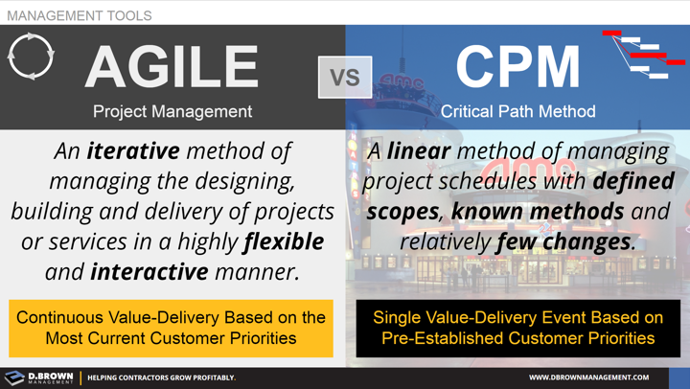
CPM vs Agile Timeline
CPM: sequential, milestone-driven.
Agile: iterative, time-boxed.
Hybrid: CPM for high-level roadmap; agile for team execution.

Slide 29
Challenges in Practice
Managing bureaucracy vs agility.
Aligning diverse gatekeepers (technical, ethical, business).
Maintaining data-driven transparency in decision-making.

Slide 30
Future of Development Processes
AI-assisted project planning and CPM prediction.
Cloud-based collaborative stage-gate systems.
Integration of sustainability and ESG metrics as new gate criteria.

Slide 31
Summary
Waterfall and Stage-Gate offer structure and discipline.
Digital firms adapt these models to become more iterative and ethical.
Microsoft’s Responsible AI illustrates a future-ready application of traditional methods.

Slide 32
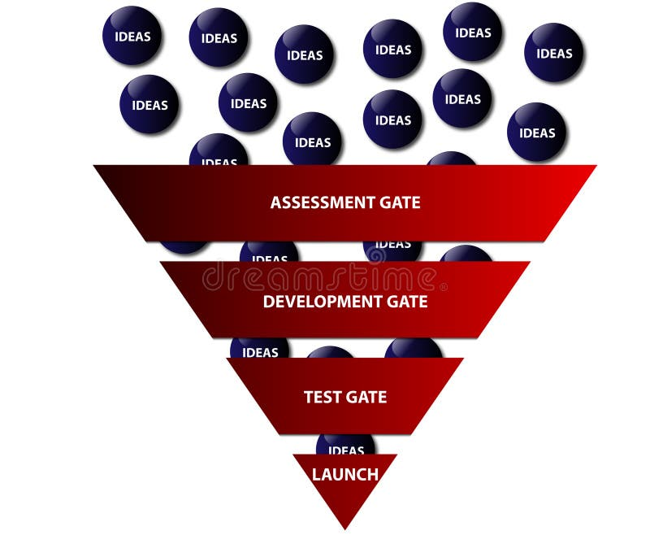
Closing Reflection
“Great innovation emerges not just from creativity, but from disciplined, ethical, and adaptive processes.”

